Slide 1
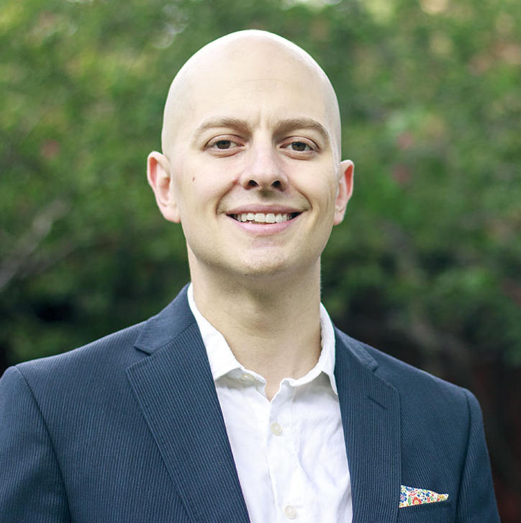
Xavier Vargas Vice President
Cloud & Product
Email
xavier.vargas@thebridge.com
Location
DFW, Texas
Mobile
(214) 502-9284
EXPERIENCE
Industry Experience
Manufacturing | Quick Service Restaurants | Retail & Hospitality | Non-Profit | Healthcare
Xavier joined The Bridge in September 2023. He has spent the past 18 years working in technology & strategy consulting helping organizations understand the impact that technology decisions have on their employees and customers.
AI Product Commercialization Strategy | Healthcare
A US News #1 ranked Children’s Hospital had developed an AI model that could be used to predict the development of a mental health disease state in pediatric patients
Created a commercialization strategy for the AI product based upon
Baseline research across possible competitors, customers, users, and partners
Compiled a Total Addressable Market based upon potential for the product
Created a commercialization roadmap inclusive of necessary FDA and clinical trials
Enterprise API Strategy & Developer Portal | Automotive
Provided analysis of a Top 3 auto manufacturer in regards to their internal API strategy as well as how they exposed these APIs with external partners and customers.
Helped client enact three key recommendations for their API strategy:
Consolidate their over 2300 API endpoints based upon pragmatic and specific standards
Enforce key requirements necessary for the publishing of both internal and external APIs
Create an internally and externally facing developer marketplace
Oversaw a team of 23 individuals across three workstreams to implement the consolidation strategy as well as the internal and external portal.
Franchisee Management System & Portal| Quick Service Restaurant
Responsible for the design, architecture, and oversight of a Franchise Management System for a globally recognized Quick Service Restaurant
Provided direction to teams of PM’s, BA’s, and engineers across numerous workstreams
Directly accountable for the on time configuration and implementation of a portal for the company’s independent Franchisees
Built trusted advisor relationships with senior leaders across the organization through both hands-on delivery and executive oversight
BACKGROUND
Functional & Technical Skills
Digital Transformation, Enterprise SaaS solutions, Customer Engagement, User Experience, IoT, Digital Twin, Enterprise & IT Governance, Salesforce
Qualifications
For the last 18 years, Xavier has helped organizations of all types by providing program leadership and guidance. Mr. Vargas has experience with all facets of the software development lifecycle, the management of distributed technical and functional teams, managing product development from roadmap to release, and implementing packaged software to enterprise customers. Xavier holds a degree in Computer Science from the University of Texas at Dallas.

Slide 2

Email
xavier.vargas@thebridge.com
Location
DFW, Texas
Mobile
(214) 502-9284
Xavier joined The Bridge in September 2023. He has spent the past 18 years working in technology & strategy consulting helping organizations understand the impact that technology decisions have on their employees and customers.
Xavier Vargas
Vice President
Cloud & Product

Slide 3
Xavier Vargas Vice President — Cloud & Product
Email
xavier.vargas@thebridge.com
Mobile
(214) 502-9284
Location
DFW, Texas
BACKGROUND
EXPERIENCE
Functional Skills
Digital Transformation, Enterprise SaaS solutions, Customer Engagement, User Experience, IoT, Digital Twin, Enterprise & IT Governance
Qualifications
For the last 18 years, Xavier has helped organizations of all types by providing program leadership and guidance. Mr. Vargas has experience with all facets of the software development lifecycle, the management of distributed technical and functional teams, managing product development from roadmap to release, and implementing packaged software to enterprise customers. Xavier holds a degree in Computer Science from the University of Texas at Dallas.
Industry Experience
Manufacturing | Quick Service Restaurants | Retail & Hospitality | Non-Profit | Healthcare
AI Product Commercialization Strategy | Healthcare
A US News #1 ranked Children’s Hospital had developed an AI model that could be used to predict the development of a mental health disease state in pediatric patients
Created a commercialization strategy for the AI product based upon
Baseline research across possible competitors, customers, users, and partners
Compiled a Total Addressable Market based upon potential for the product
Created a commercialization roadmap inclusive of necessary FDA and clinical trials
Enterprise API Strategy & Developer Portal | Automotive
Provided analysis of a Top 3 auto manufacturer in regards to their internal API strategy as well as how they exposed these APIs with external partners and customers.
Helped client enact three key recommendations for their API strategy:
Consolidate their over 2300 API endpoints based upon pragmatic and specific standards
Enforce key requirements necessary for the publishing of both internal and external APIs
Create an internally and externally facing developer marketplace
Oversaw a team of 23 individuals across three workstreams to implement the consolidation strategy as well as the internal and external portal.
Franchisee Management System & Portal| Quick Service Restaurant
Responsible for the design, architecture, and oversight of a Franchise Management System for a globally recognized Quick Service Restaurant
Provided direction to teams of PM’s, BA’s, and engineers across numerous workstreams
Directly accountable for the on time configuration and implementation of a portal for the company’s independent Franchisees
Built trusted advisor relationships with senior leaders across the organization through both hands-on delivery and executive oversight

